Slide 1
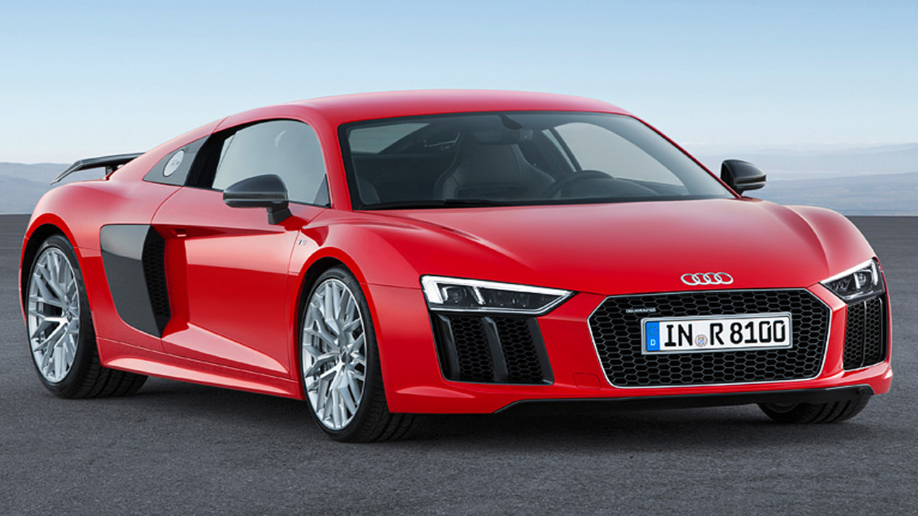
Car Brand
Analysis

Slide 2
Project Overview
Project Title: Popular Vehicles of 2024
Key Brands Analyzed:
Toyota, Ford, Honda, Tesla
Data Formats:
CSV files, visualizations (graphs)
Data Overview
Data Sources:
National Highway Traffic Safety Administration (NHTSA)
Insurance Institute for Highway Safety (IIHS)
U.S News Rating
Notes:
Our analysis of popular vehicles in 2024 centers on four leading manufacturers: Ford, Toyota, Honda, and Tesla. Using data from the NHTSA API, IIHS, and U.S. News Ratings, we compiled detailed insights into vehicle models from these brands, providing a comprehensive understanding of consumer experiences.
Now, to dive deeper into the insights from our analysis, I'd like to hand it over to [Dotan], who will walk us through some key findings and his implications.

Slide 3

What vehicle had the ‏best rating according to US News in 2024

Slide 4
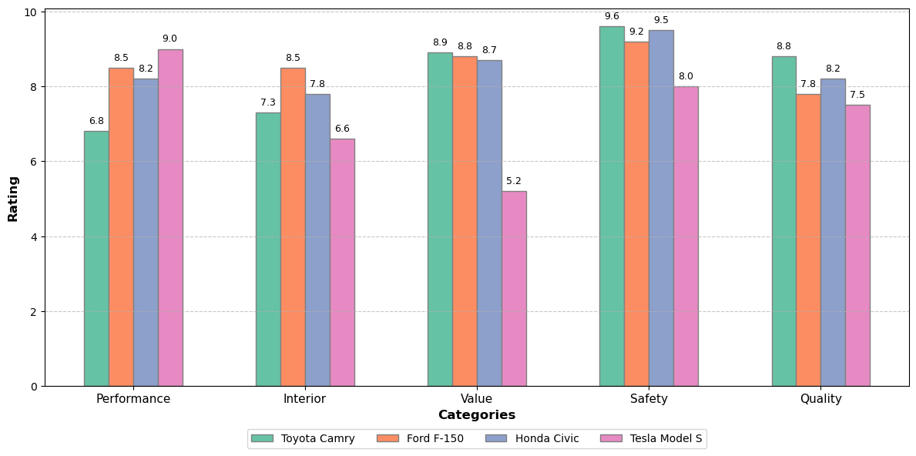

Slide 5
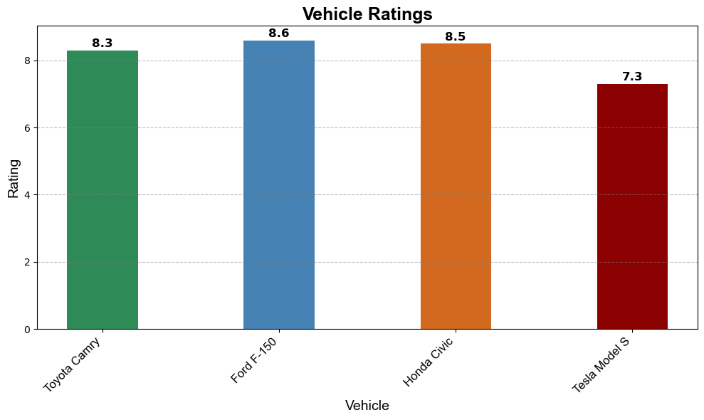
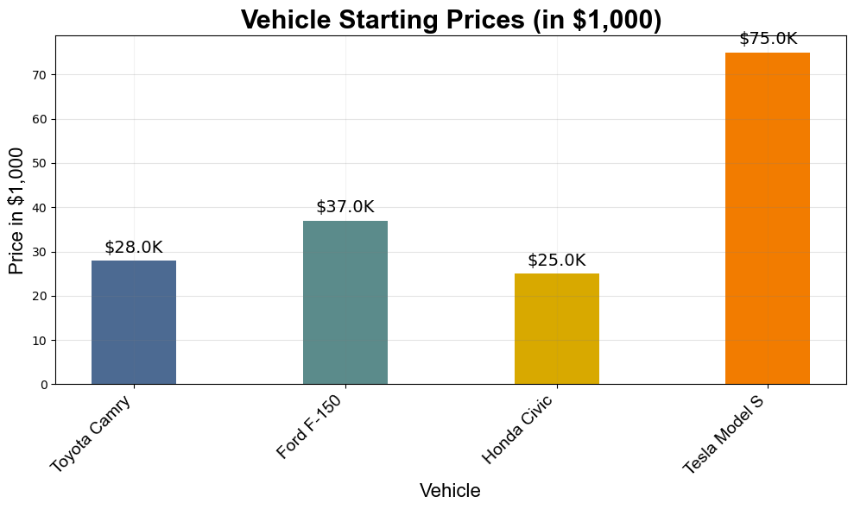
Tesla Model S got the lowest rating on quality, safety, value, and interior but the highest on performance.
Honda Civic have the most affordable pricing and perform very well in all of the metrics.
Toyota Camry got the highest rating on quality and safety but got a low rating on performance.
Ford F-150 got the best overall rating, that could be explained by the versatility and towing capacity.

Slide 6
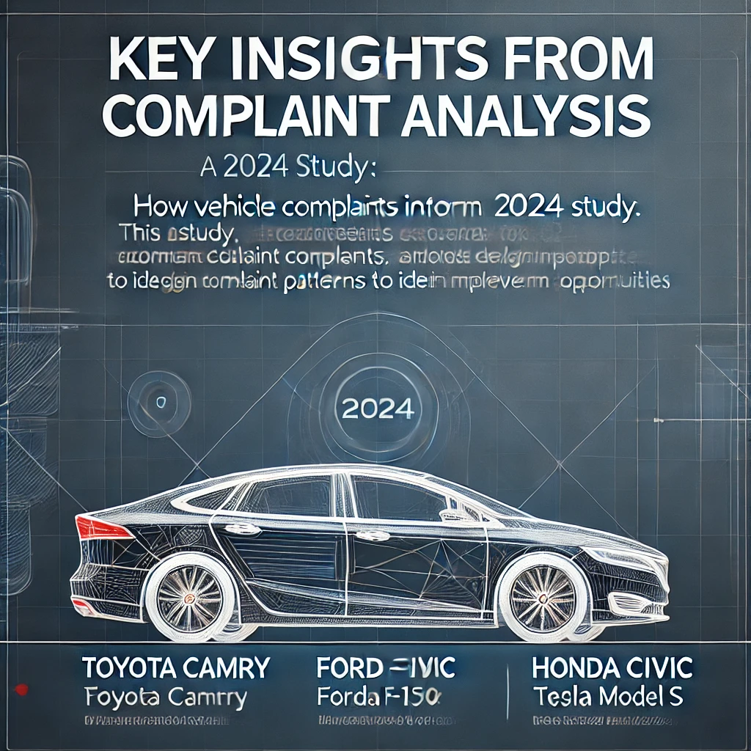
“How Vehicle Complaints Inform Better Design: A 2024 Study”
Notes:
Vehicle complaints serve as a critical feedback mechanism for automakers, offering insights into real-world issues experienced by drivers. By analyzing these complaints, manufacturers can identify design weaknesses, prioritize improvements, and enhance overall vehicle quality and user satisfaction.

Slide 7
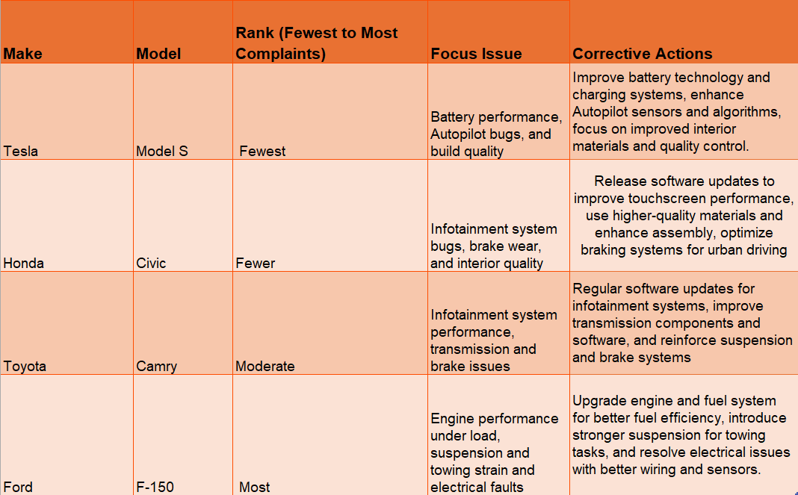
Notes:
This table summarizes key complaint trends for popular 2024 vehicle models, along with their possible causes and recommended corrective actions:
We have from Most to Fewest complaints
These findings underscore the influence of vehicle type, usage, and brand reputation on complaint trends, offering valuable insights for product improvement and design optimization.

Slide 8
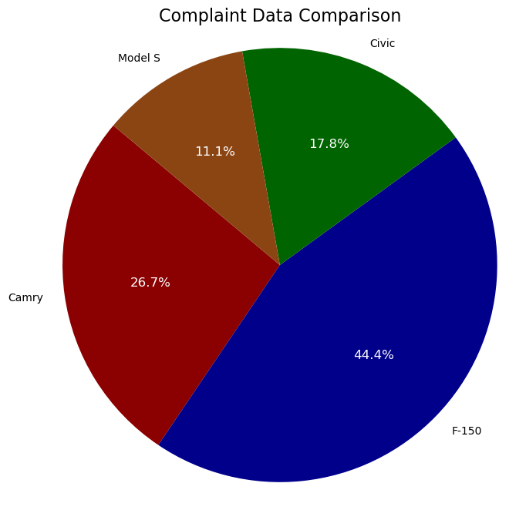
Notes:
Tesla Model S had the lowest complaints, reflecting a focus on innovative tech. In contrast, the Ford F-150 faced the highest issues, primarily tied to its versatile usage.
To visualize, a pie chart shows the distribution of complaints,
Tesla Model S: Fewest complaints 11.1% (5)
Ford F-150: Highest complaints 44.4% (20)
Honda Civic: Lower complaints 17.8% (8)
This analysis highlights areas where automakers can enhance reliability and consumer satisfaction.
With that in mind, there's even more to uncover about vehicle performance and safety. I'll now hand it over to [Anthony] to share additional insights. Over to you!

Slide 9
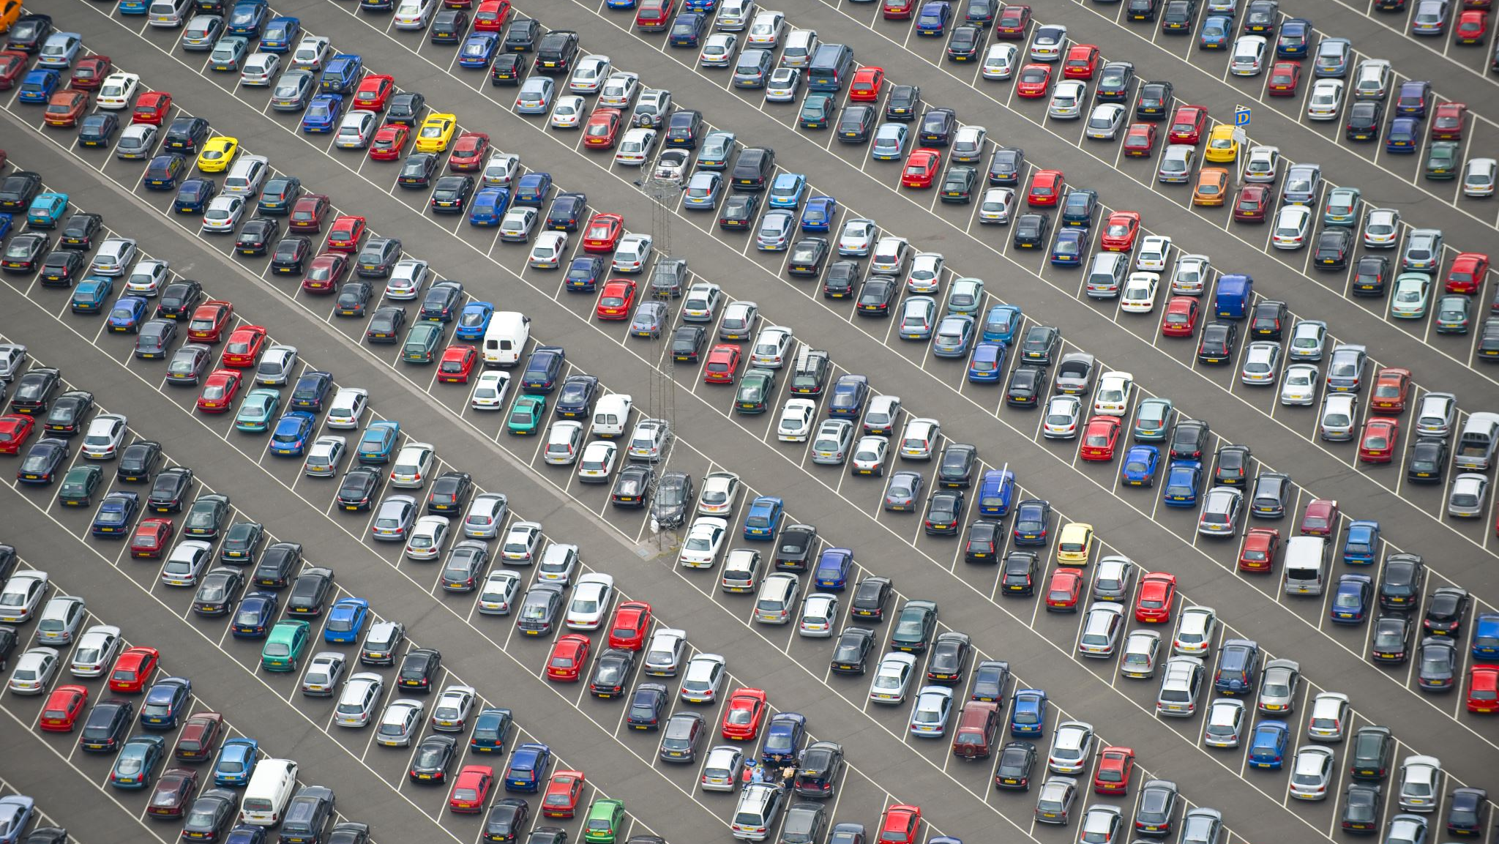
What car brand had the least amount of recalls in 2024?

Slide 10

In 2024, the automotive industry in the United States experienced a significant number of vehicle recalls
Total Recalls and Affected Vehicles as of August 8, 2024, there were 250 recalls affecting approximately 10.1 million vehicles. By the end of the year, this number increased to over 27 million vehicles recalled, a decrease from 33 million in 2023.
Manufacturers with the Most Recalls: Chrysler led with 39 recalls, affecting over 2.6 million vehicles. Ford followed with 37 recalls, impacting approximately 3.6 million vehicles. Other manufacturers with significant recall numbers included BMW (19 recalls), Hyundai (17 recalls), and Kia America (15 recalls).

Slide 11
Make | Model | Year | NHTSACampaignNumber | Component | Summary | Consequence | Remedy
Toyota | Camry | 2024 | 24V128000 | SEATS | Insufficiently welded head restraint brackets. | May not properly restrain occupants during a crash, increasing injury risk. | Dealers will replace the rear seat-back frame.
Ford | F-150 | 2024 | 24V329000 | STEERING: COLUMN | Incorrect fastener in the steering column lower shaft. | Loss of steering control increases crash risk. | Dealers will replace the lower steering shaft fastener.
Honda | Civic | 2024 | 23V704000 | STEERING: RACK AND PINION | Incorrectly assembled power steering rack may cause tire damage. | A damaged tire can fail, increasing crash risk. | Dealers will inspect and replace the power steering rack as necessary.
Tesla | Model S | 2024 | 24V376000 | SEAT BELTS: FRONT: WARNING LIGHT/DEVICES | Seat belt warning light may not activate for unbelted drivers. | Increases the risk of injury during a crash. | Tesla will release an over-the-air software update.

Slide 12
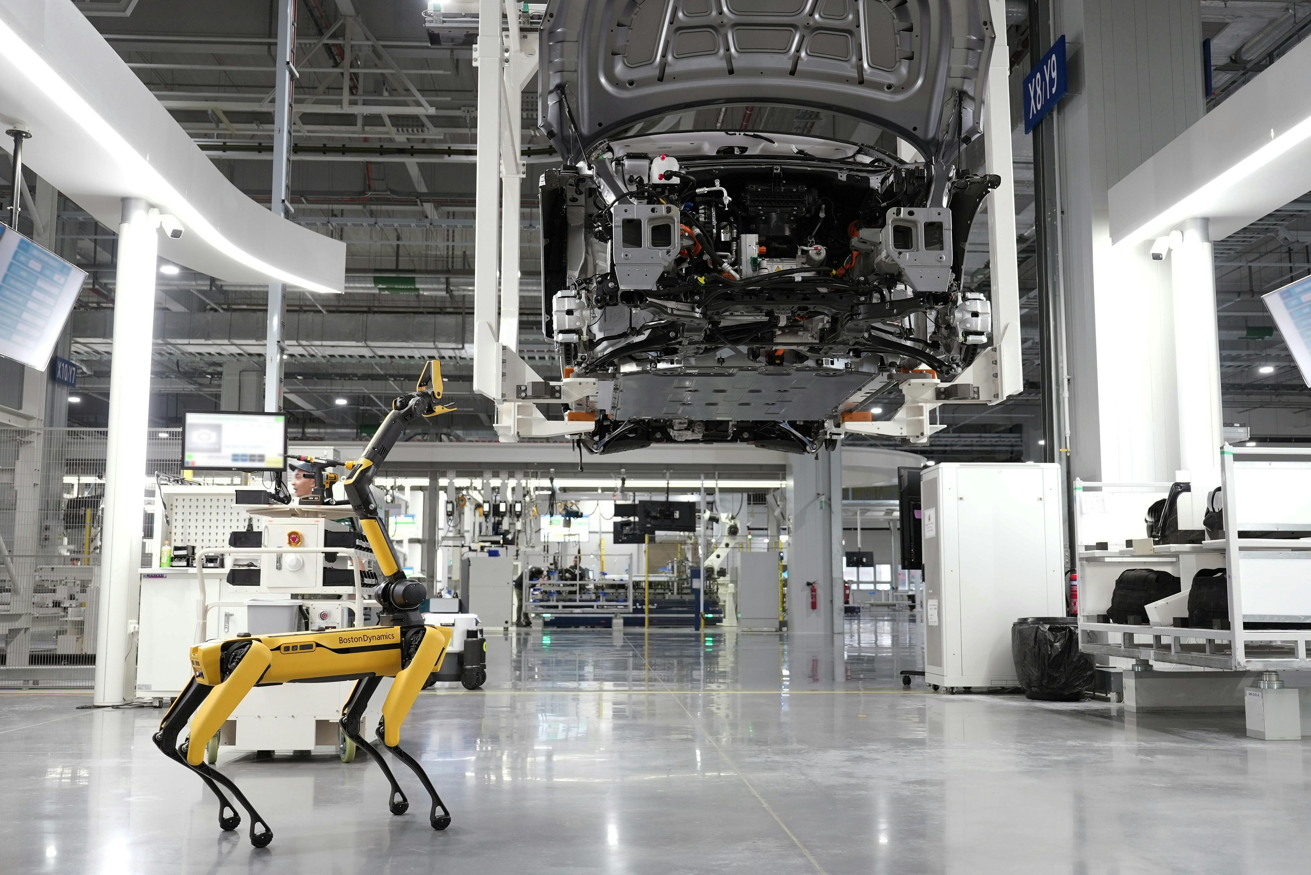
The most frequently recalled component across these vehicles is steering (both column and rack-and-pinion), affecting both Ford F-150 and Honda Civic.
Recalls Due to Improper Assembly or Installation stemmed from incorrect assembly or improper manufacturing, including issues like improperly welded seat brackets (Toyota Camry), improperly bonded windshields (Ford F-150), and steering rack assembly issues (Honda Civic).
Airbags and Safety Features, including airbags (Ford F-150, Tesla Model S) and seat belt warnings (Tesla Model S).

Slide 13
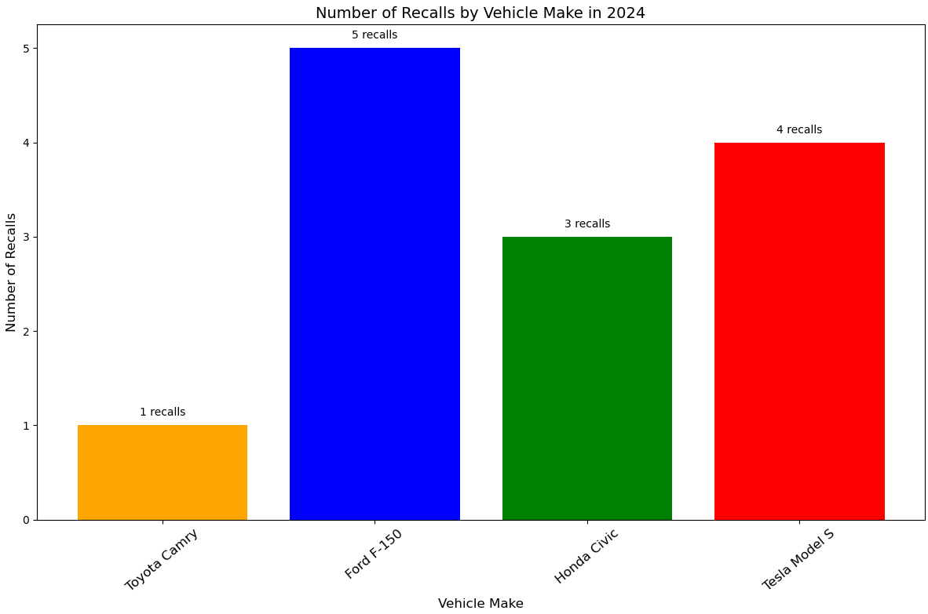

Slide 14
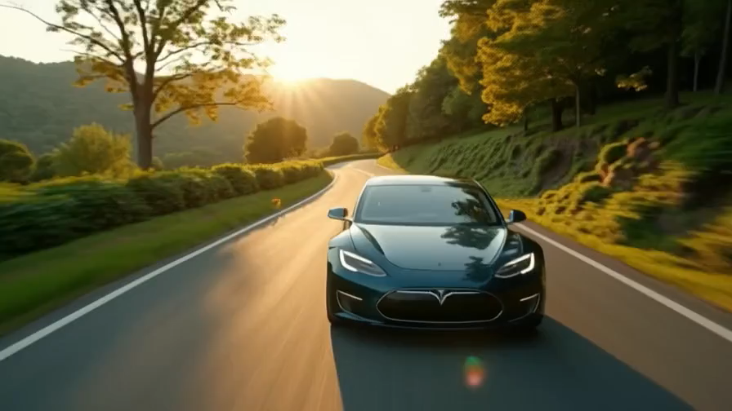
Conclusion?

